Slide 1
Caching files with a service worker
What's in a Cache?

Slide 2
What is the Cache interface?
Used to store assets that have a URL
Formally: "a request to response map" (spec)
Methods
add(request), addAll(request), put(request, response), delete(request, options?)
keys(request?, options?), match(request, options?), matchAll(request, options?),
Entry point is self.caches (in service worker) and window.caches (in page)
Notes:
While this API was intended for service workers it is actually exposed on the window, and can be accessed from anywhere in your scripts. The entry point is caches.
You are responsible for implementing how your script (service worker) handles updates to the cache. All updates to items in the cache must be explicitly requested; items will not expire and must be deleted.
You are also responsible for periodically purging cache entries. Each browser has a hard limit on the amount of cache storage that a given origin can use. The browser does its best to manage disk space, but it may delete the Cache storage for an origin. The browser will generally delete all of the data for an origin or none of the data for an origin.
Make sure to version caches by name and use the caches only from the version of the script that they can safely operate on.

Slide 3
Building a simple application cache
Service worker event | Action
install | Build cache; add initial resources
activate | Update cache
fetch | Retrieve from cache, network, or database
Notes:
In the next 3 slides, we outline a few common patterns for caching resources.
We will look at caching files on install, on user interaction, and on network response.

Slide 4
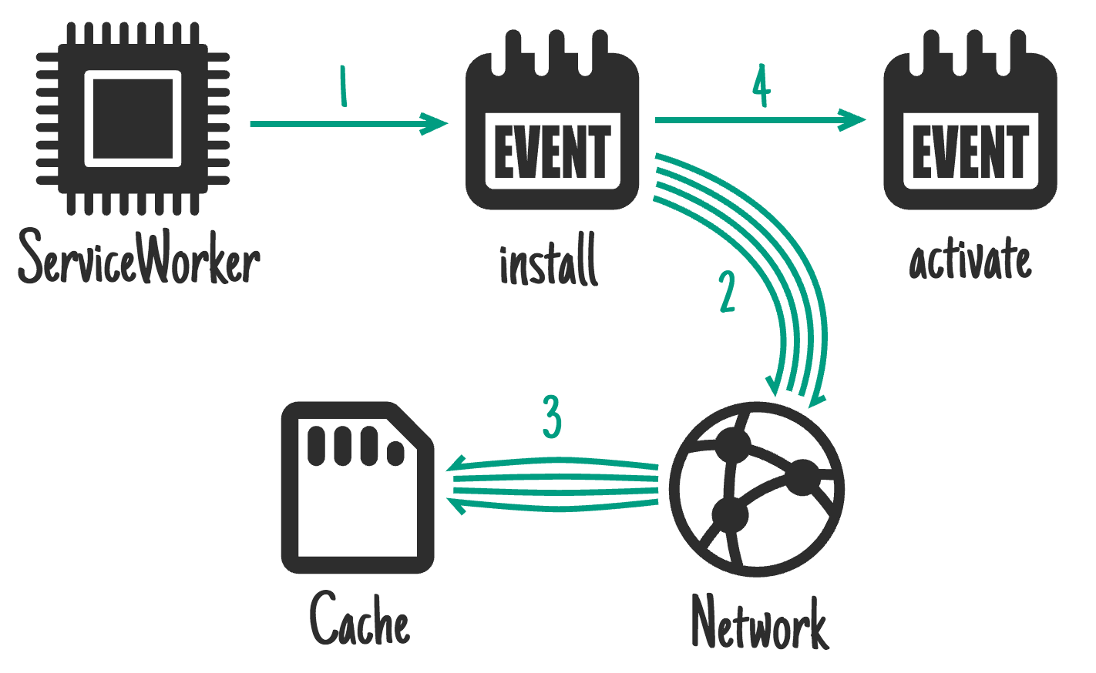
On install: cache the application shell
Notes:
We can cache sites static resources in the install event in the service worker

Slide 5
On install: caching the application shell
var cacheName = 'app-shell-cache-v1';
var filesToCache = ['/', '/index.html', ...];
self.addEventListener('install', event => {
event.waitUntil(
caches.open(cacheName).then(cache => {
return cache.addAll(filesToCache);
}).then(() => {
return self.skipWaiting();
})
);
});
Notes:
We can cache the HTML, CSS, JS, and any static files that make up the application shell in the “install” event of the service worker
It is important to note that while the “install” event is happening, any previous version of your service worker is still running and serving pages, so the things you do here mustn't disrupt that.
event.waitUntil takes a promise to define the length & success of the install. If the promise rejects, the installation is considered a failure and this ServiceWorker will be abandoned (if an older version is running, it'll be left intact). caches.open and cache.addAll return promises.
If any of the resources fail to fetch, the cache.addAll call rejects.

Slide 6
On activate: Remove outdated caches
self.addEventListener('activate',e => {
e.waitUntil(
caches.keys().then(keyList => {
return Promise.all(keyList.map(key => {
if (key !== cacheName) return caches.delete(key);
}));
}));
return self.clients.claim();
});
Notes:
There are plenty of ways to do this, but in this case, we iterate over the list of keys from the cache, then delete any caches that don't match the current cache name.

Slide 7
On fetch: Retrieve w/ network fallback
self.addEventListener('fetch', event => { event.respondWith(
caches.match(event.request)
.then(response => { return response || fetch(event.request); }) ); });
Notes:
If you're making your app offline-first, this is how you'll handle the majority of requests. Other patterns will be exceptions based on the incoming request.
If the resource exists in the cache, this code will return it from there. Otherwise it will send the request on to the network.

Slide 8
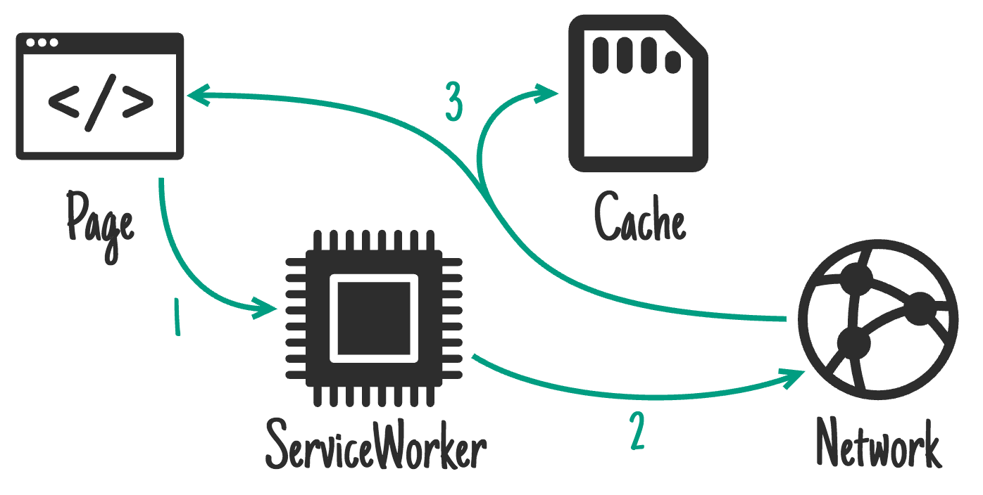
On network response
Notes:
We can intercept the request in the service worker, cache a clone of the response, and send the response itself to the page.

Slide 9
On network response
self.addEventListener('fetch',event => { event.respondWith( return fetch(event.request) .then(response => { cache.put(event.request, response.clone()); return response; }) ); });
Notes:
This approach works best for resources that frequently update such as a user’s inbox or article contents. This is also useful for non-essential content such as avatars, but care is needed. If a request doesn't match anything in the cache, get it from the network, send it to the page and add it to the cache at the same time. If you do this for a range of URLs, such as avatars, you'll need to be careful you don't bloat the storage of your origin — if the user needs to reclaim disk space you don't want to be the prime candidate. Make sure you get rid of items in the cache you don't need any more.
To allow for efficient memory usage, you can only read a response/request's body once. In the code above, .clone() is used to create additional copies that can be read separately.

Slide 10
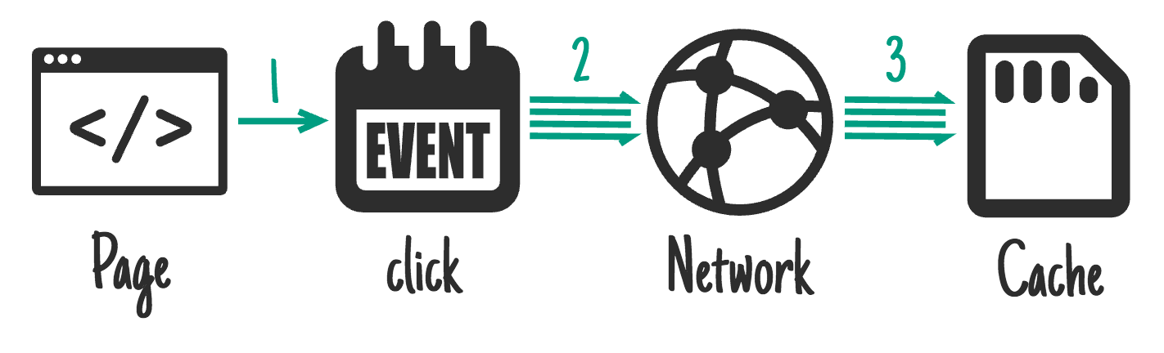
On user interaction
Notes:
When the user clicks on an element in our page, we can add the element to the cache.

Slide 11
On user interaction (1)
document.querySelector('.article').addEventListener('click', function(event) {
event.preventDefault();
var id = this.dataset.articleId;
Notes:
If the whole site can't be taken offline, you may allow the user to select the content they want available offline (e.g. a video on something like YouTube, an article on Wikipedia, a particular gallery on Flickr).
Give the user a "Read later" or "Save for offline" button. When it's clicked, fetch what you need from the network and put it in the cache.
The caches API is available from pages as well as service workers, meaning you don't need to involve the service worker to add things to the cache.

Slide 12
On user interaction (2)
caches.open('mysite-article-' + id).then(function(cache) { fetch('/get-article-urls?id=' + id).then(function(response) { return response.json(); }).then(function(urls) { cache.addAll(urls); }); }); });
Notes:
We create a cache with a name corresponding to the specific article. Then we fetch the article and add it to the cache.

Slide 13
Serving files from the cache

Slide 14
Serving files from the cache
Cache falling back to network
Network falling back to cache
Cache then network
Generic fallback
Notes:
The next 4 slides will cover several approaches to this: cache falling back to network, network falling back to cache, cache then network, and generic fallback

Slide 15
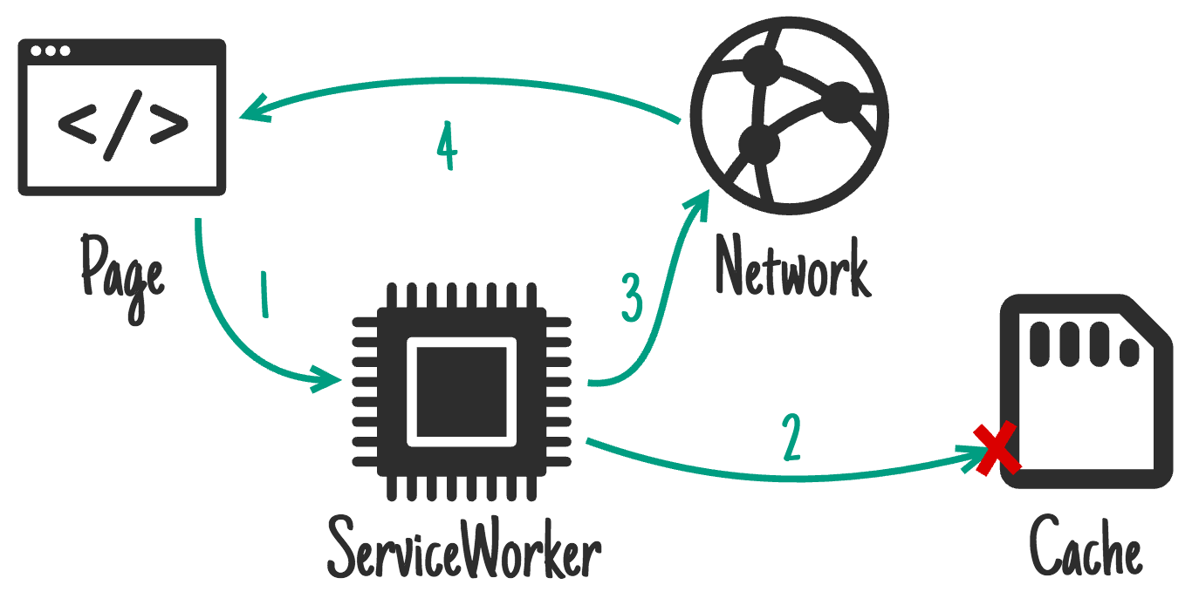
Cache falling back to the network
Notes:
The request is intercepted by the service worker
We look for a match in the cache
If that fails we send the request to the network
We return the response

Slide 16
Cache falling back to the network
self.addEventListener('fetch', function(event) { event.respondWith(
caches.match(event.request)
.then(function(response) { return response || fetch(event.request); }) ); });
Notes:
If you're making your app offline-first, this is how you'll handle the majority of requests. Other patterns will be exceptions based on the incoming request.
If the resource exists in the cache, this code will return it from there. Otherwise it will send the request on to the network.

Slide 17
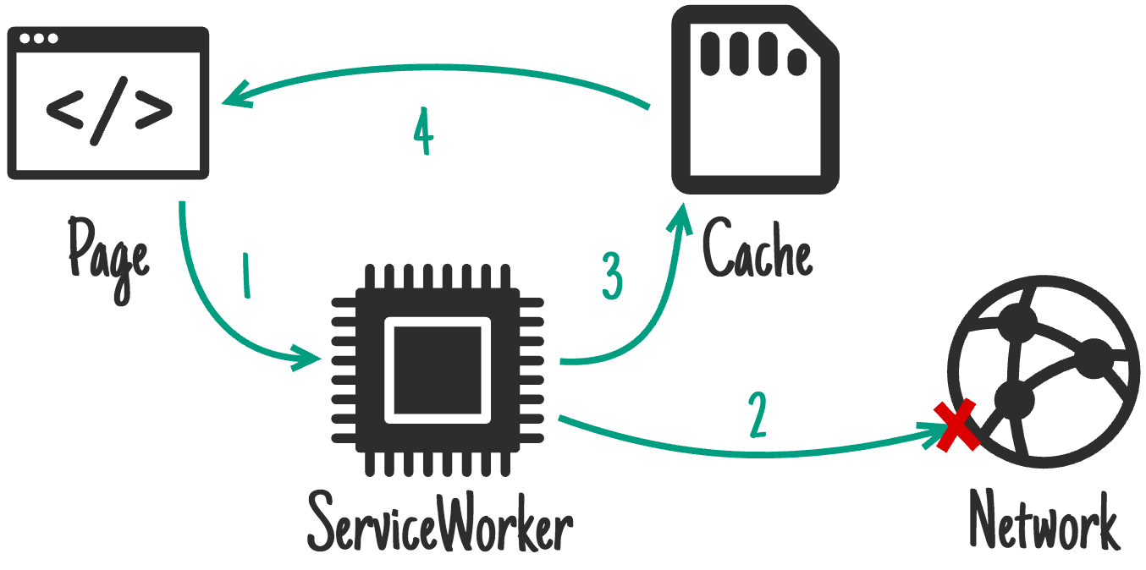
Network falling back to the cache
Notes:
The request is intercepted by the service worker
We send the request to the network
If that fails we look for a mtach in the cache
We return the response

Slide 18
Network falling back to the cache
self.addEventListener('fetch', function(event) { event.respondWith( fetch(event.request).catch(function() { return caches.match(event.request); }) ); });
Notes:
In the above code, we first send the request to the network using fetch(), and only if it fails do we look for a response in the cache.
This is a good approach for resources that update frequently, that are not part of the "version" of the site (e.g. articles, avatars, social media timelines, game leader boards).
Handling network requests this way means the online users get the most up-to-date content, but offline users get an older cached version.
However, this method has flaws: If the user has an intermittent or slow connection they'll have to wait for the network to fail before they get content from the cache. This can take an extremely long time and is a frustrating user experience.
The approach in the next slide “Cache then network” is a better solution.

Slide 19
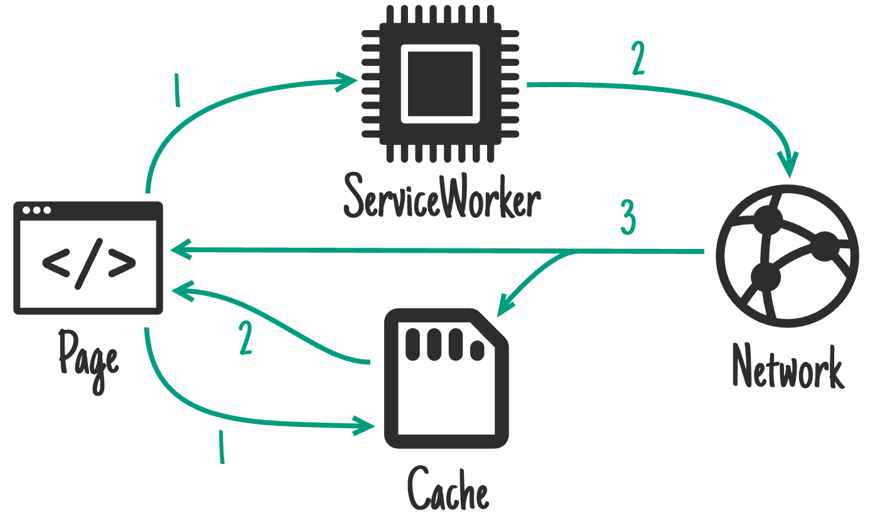
Cache then network
Notes:
Requests are sent from the page simultaneously to the

Slide 20
Cache then network (1)
var networkDataReceived = false; var networkUpdate = fetch('/data.json')
.then(function(response) { return response.json(); }).then(function(data) { networkDataReceived = true; updatePage(data); });
Notes:
Code in main javascript, not service worker.
This is a good approach for resources that update frequently, that are not part of the "version" of the site (e.g. articles, avatars, social media timelines, game leader boards). This approach will get content on screen as fast as possible, but still display up-to-date content once it arrives.
This requires the page to make two requests, one to the cache, one to the network. The idea is to show the cached data first, then update the page when/if the network data arrives.
In the above code, we are sending a request to the network, and in the next slide is the code to look for the resource in the cache.
The cache will most likely respond first and, if the network data has not already been received, we update the page with the data in the response (code for this on the next slide). When the network responds we update the page again with the latest information.
Sometimes you can just replace the current data when new data arrives (e.g. game leaderboard), but that can be disruptive with larger pieces of content.

Slide 21
Cache then network (2)
caches.match('/data.json').then(function(response) { return response.json(); }).then(function(data) {
if (!networkDataReceived) {
updatePage(data);
}
}).catch(function() { return networkUpdate; })
Notes:
This code looks for /data.json in the cache. This will most likely respond before the request to the network and update the page if the network hasn’t already responded. If the network responds after the cache, it updates the page again.
If getting the response from the cache fails, it tries the network again as a last attempt.

Slide 22
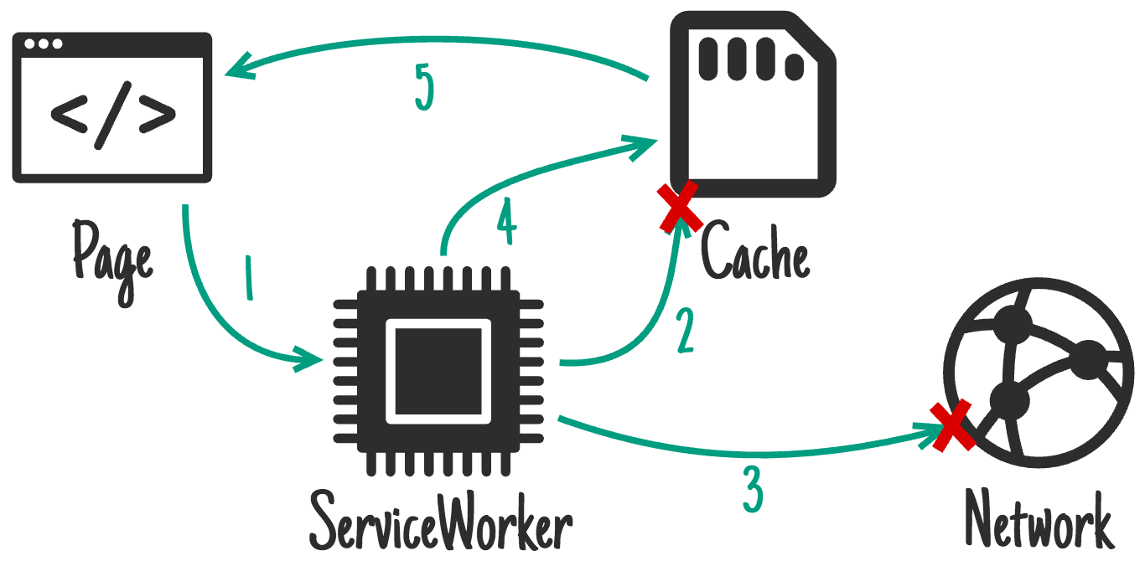
Generic Fallback
Notes:
If the request is not found in both the cache and on the network, respond with a precached custom "offline" page.

Slide 23
Generic fallback
self.addEventListener('fetch', function(event) { event.respondWith(
caches.match(event.request).then(function(response) { return response || fetch(event.request); }).catch(function() { return caches.match('/offline.html'); }) ); });
Notes:
If you fail to serve something from the cache and/or network you may want to provide a generic fallback. This technique is ideal for secondary imagery such as avatars, failed POST requests, "Unavailable while offline" page.
In practice you'd have many different fallbacks, depending on URL & headers. Eg, a fallback silhouette image for avatars
The item you fallback to is likely to be an install dependency (e.g. cached on the install event of the service worker).

Slide 24
Remove outdated caches
self.addEventListener('activate', function(event) {
event.waitUntil(
caches.keys().then(function(cacheNames) {
return Promise.all(
cacheNames.map(function(cacheName) {
if (cacheName !== 'currentCacheVersion') {
return caches.delete(cacheName);
...
});
Notes:
Once a new ServiceWorker has installed & a previous version isn't being used, the new one activates, and you get an activate event. Because the old version is out of the way, it's a good time to delete unused caches.
During activation, other events such as fetch are put into a queue, so a long activation could potentially block page loads. Keep your activation as lean as possible, only use it for things you couldn't do while the old version was active.
It’s important to remember that caches are shared across the whole origin

Slide 25
Resources
Resources
Offline Cookbook
Offline storage for Progressive Web Apps
Persistent Storage
navigator.storage.estimate()
Notes:
Jake Archibald’s offline cookbook contains all of this information and more

Slide 26
Lab overview
Cache the application shell
Intercept network requests and serve files from the cache
Add the network responses to the cache
Respond to network errors with an offline page
Delete outdated caches
Notes:
Lab explores the basics of working with the Cache API in the service worker.
Full explanations of all the different caching strategies and the Cache API are in the text pdf

Slide 27
Extra Credit

Slide 28
Storage limitations and warnings
Browser | Limitation | Notes
Chrome and Opera | No limit. | Storage is per origin not per API
Firefox | No limit. | Prompts after 50 MB
Mobile Safari | 50MB.
Desktop Safari | No limit. | Prompts after 5MB
Internet Explorer (10+) | 250MB. | Prompts after 10MB
Notes:
There’s no storage limit in Chrome and Opera. Storage here is per origin rather than per API. In other words, local storage, session storage, service worker cache and IndexedDB all share the same space.
Firefox has no limits, but will prompt for confirmation from the user after 50MB have been stored in the browser.
Mobile Safari is limited to 50MB.
Desktop Safari has no limit and prompts for confirmation when it has stored 5MB.
IE has a 250MB limit and prompts after 10MB have been stored.

